Slide 1

Health Care Insurance (HCI) Co.
Data Pipeline Integration
Data Engineer
Shourav Dey

Slide 2
Problem Statement(s)
The need of scalable, optimized and secure data pipeline.
Understanding Customer Behavior
Analyze Competitors’ data
Initiative to create customized offers and royalty programs

Slide 3
Goals
The data pipeline prototype will:
Boost revenue
Provide insights
Clean and validate data for decision making
Promote targeted marketing segmentation
Enable data scientists to perform hassle-free data analysis and deploy ML models.

Slide 4
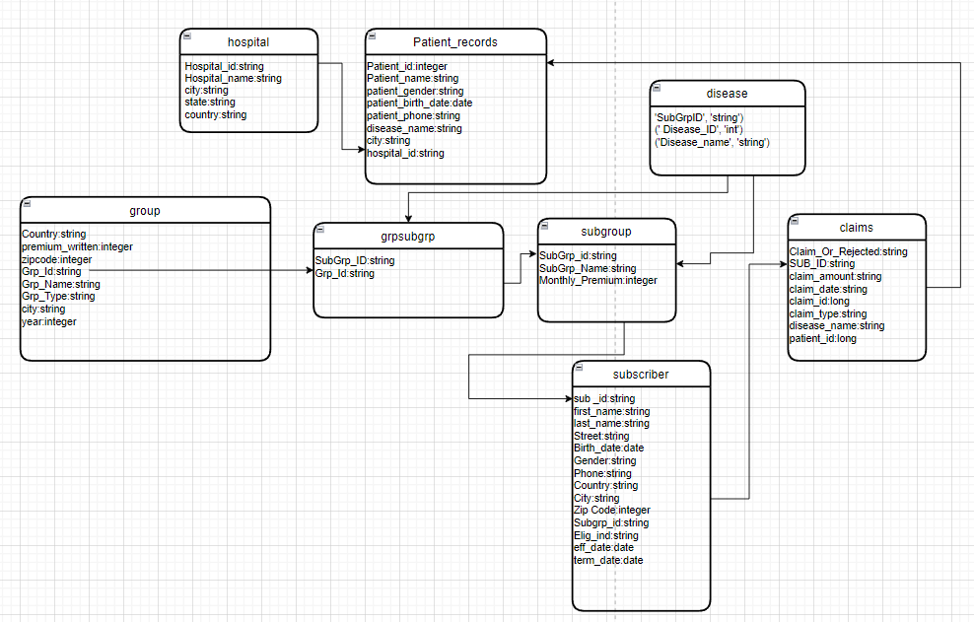
Dataset and ERD
8 tables are present
They were stored in their raw csv and json format in S3
After cleaning they were stored in S3
For analysis temp view table was created in Databricks to run SQL queries
Output were stored in Redshift

Slide 5
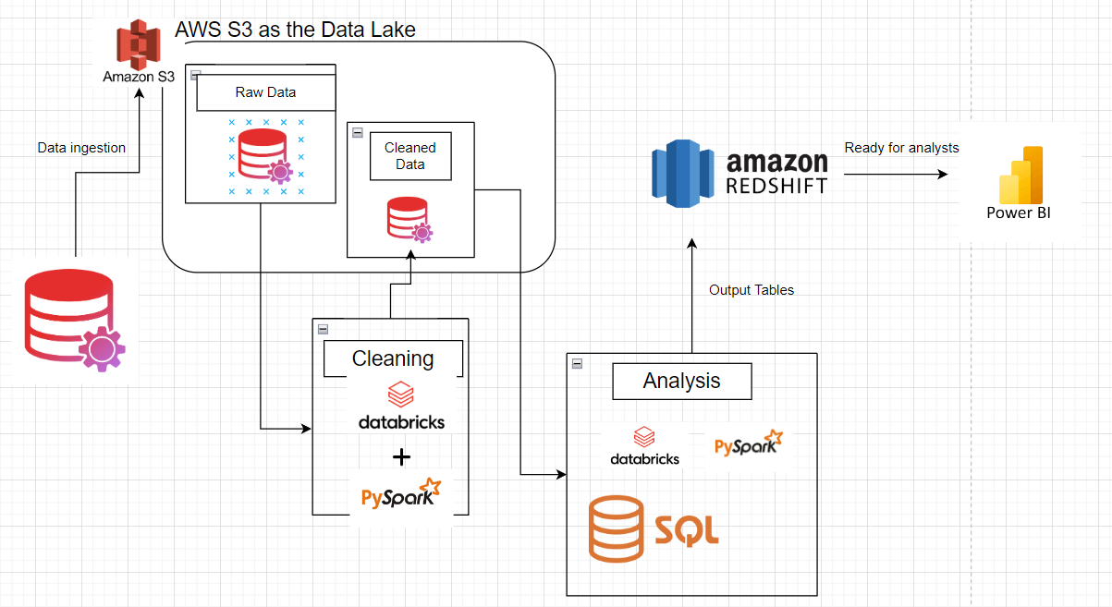
ETL Pipeline
Requirements:
AWS S3:
IAM Roles
AccessKey
SecretKey
S3 URI
Databricks:
Driver, 2 cores, 15.3 GB RAM and 1DBU
12.2 LTS (Apache Spark 3.3.2)
Average processing time less than 5s.
AWS Redshift:
IAM Roles
Database and schema (set up)
Tempdir in S3 for data ingestion from Databricks
User ID and Pass.

Slide 6
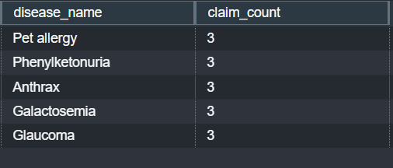
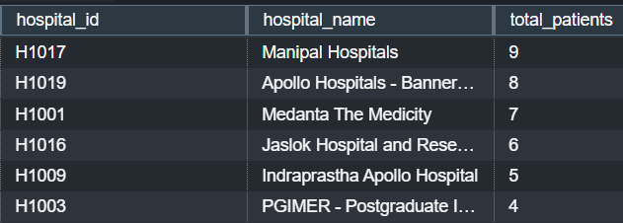
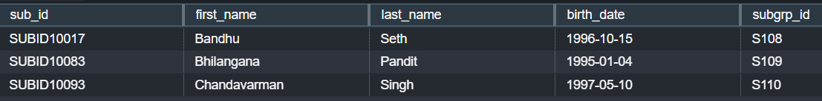
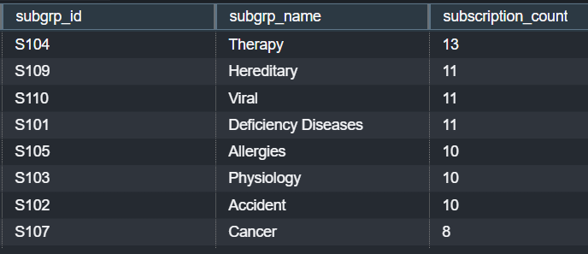
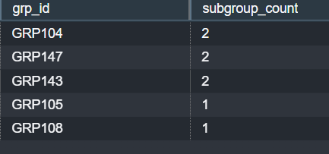
USE CASES
1. Which disease has a maximum number of claims.
4 Find out hospital which serve the most number of patients.
2 Find those Subscribers having age less than 30 and they subscribe any subgroup
3 Find out which group has maximum subgroups.
5 Find out which subgroups subscribe the most number of times.

Slide 7
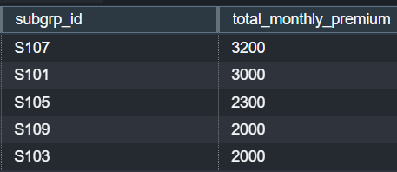

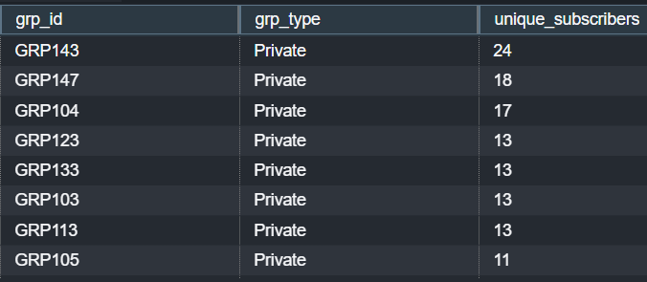
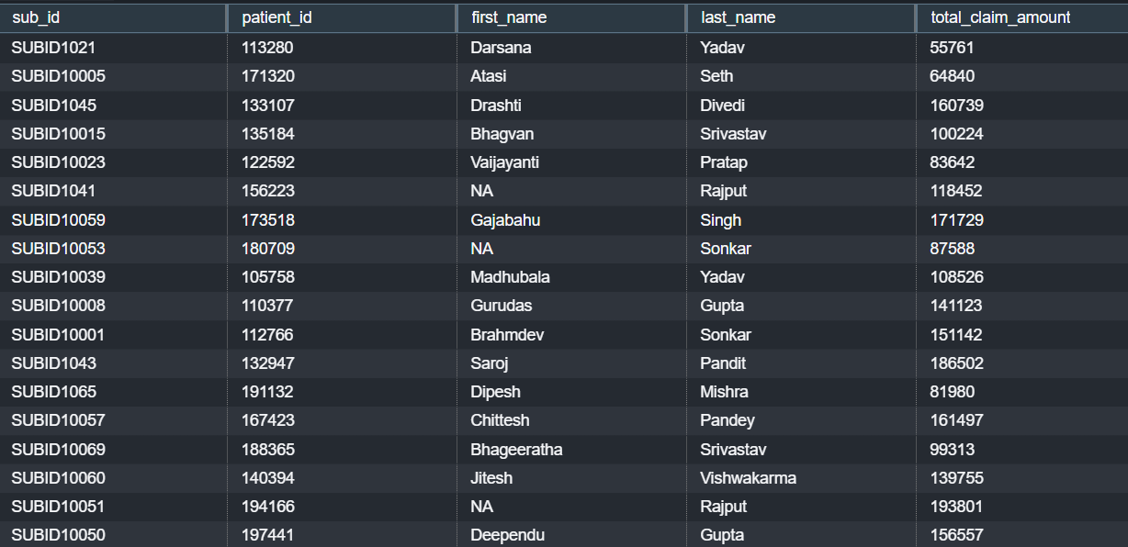
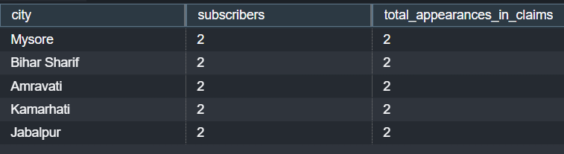

Use Cases Continued
6 Find out total number of claims which were rejected
8 Which groups of policies subscriber subscribe mostly Government or private (group type)
10. Find out Which group is most profitable
11. List patients who have cashless insurance and have total charges greater than or equal for Rs. 50,000.
7 From where most claims are coming (city)
9 Average monthly premium subscriber pay to insurance company.

Slide 8
Findings and Limitations
Based on our analysis:
1. Sending promotions to the patients with diseases like Glaucoma or the diseases that hits most number of claims.
2. There are a very few subscribers under the age of 30 but targeted marketing campaign can retain lifetime loyalty.
3. Get on board with the hospitals with high count of patients.
4. Run marketing campaigns in the cities with most claims.
5. The biggest competitors are all from the Private sector and average premium is Rs. 1870/month.
6. Also work with cancer patients since they are the most profitable groups and subscribe the most times maybe offer them discounts or lower rate of monthly premium.
Limitations:
No automated scripts were deployed for the prototype.
Use of Lambda function or Glue for on demand automation and further scalability if budget permits.

Slide 9
Thank you! Any Questions ?

